Slide 1
Struggle Against Hunger
Food Security through Education, Food Production and Micro-Business Development

Slide 2
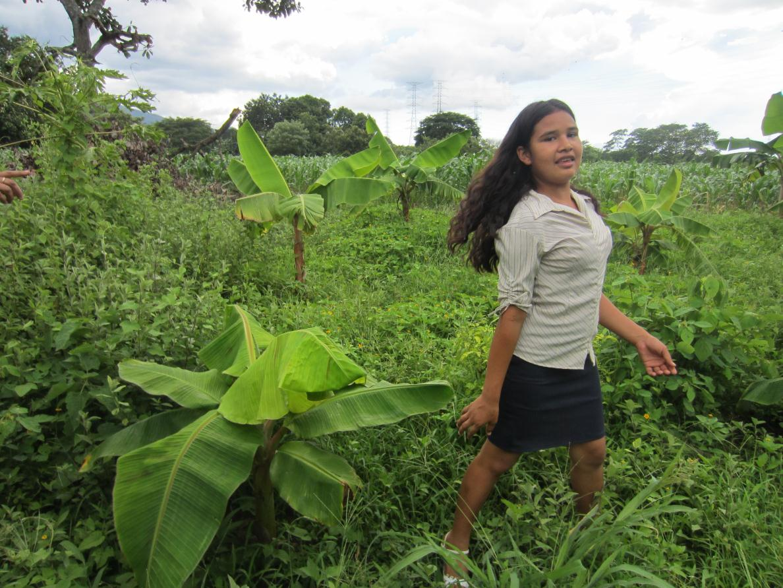
Fe y Esperanza

Slide 3
Mayan Corn vs. Modern Corn
An experiment to see what corn seed produces the best and most corn

Slide 4
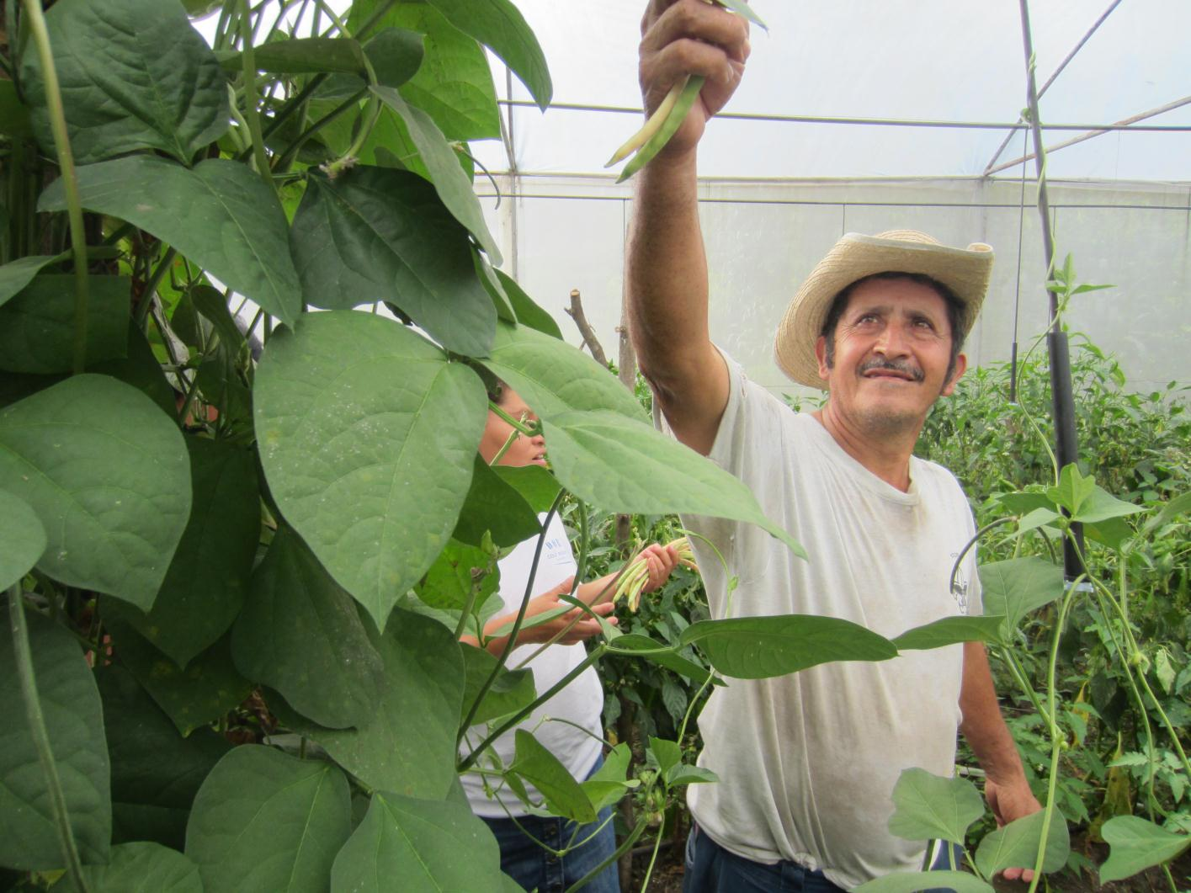

Slide 5
Small Space Gardening
Urban gardeners learn to grow large quantities of food with a small amount of soil, using organic fertilizer which can be made from home compost

Slide 6
Learning about plantains

Slide 7
Drip Irrigation

Slide 8
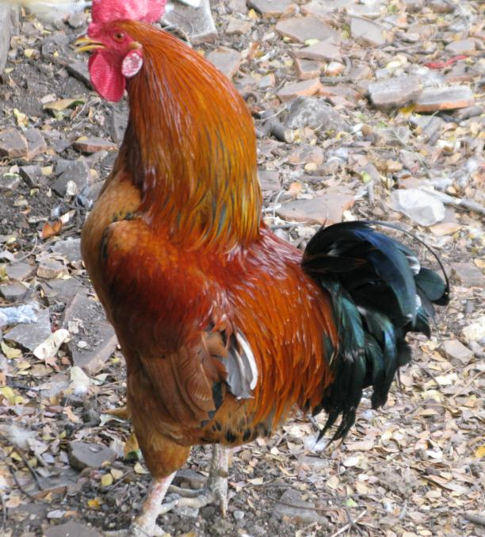
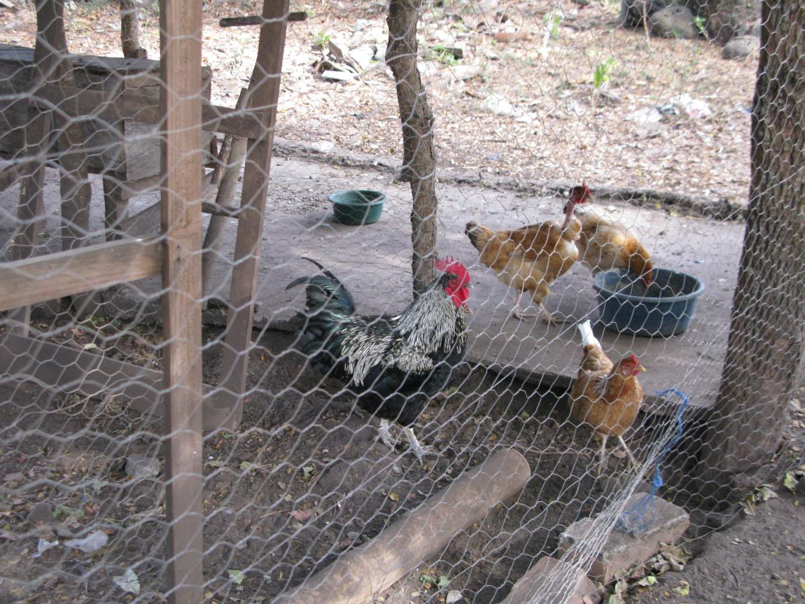
Animal projects

Slide 9
Micro-Business - Making Purses & Backpacks

Slide 10
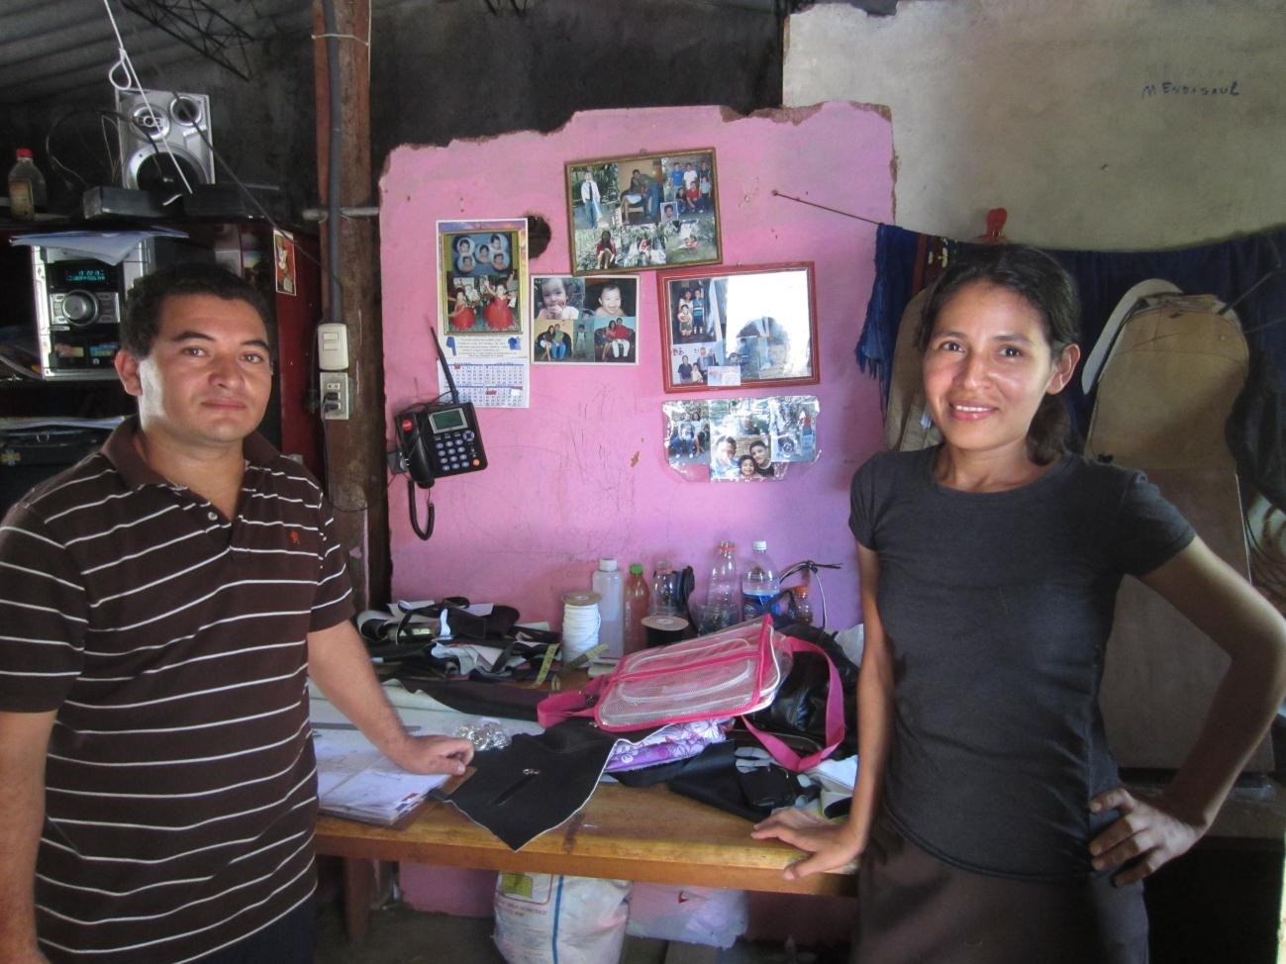

Slide 11
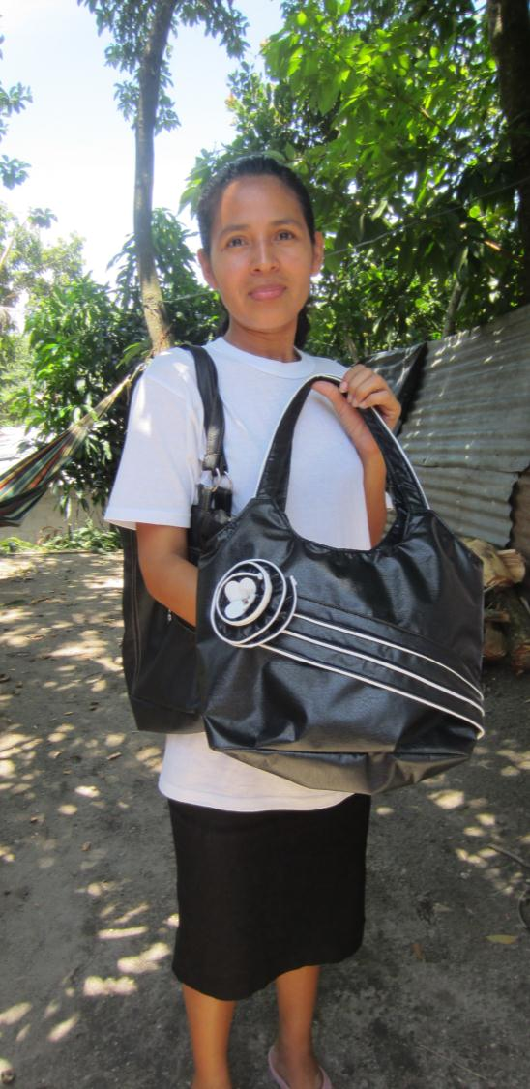
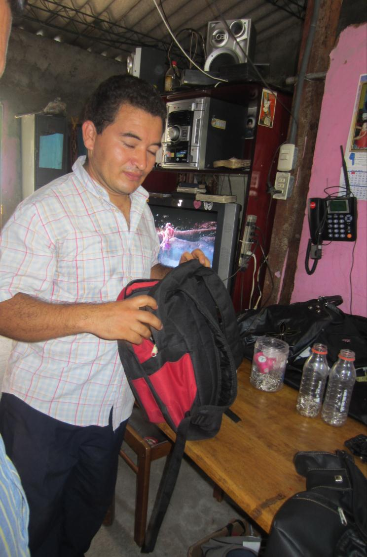

Slide 12
